Slide 1
Version 2

Slide 2
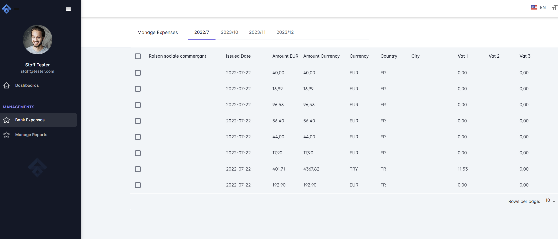

1. B inputs the excel files of Bank
FMO
EGE
FMO
TOM
B is a manager and will input the bank expenses for different employees (A).

Slide 3
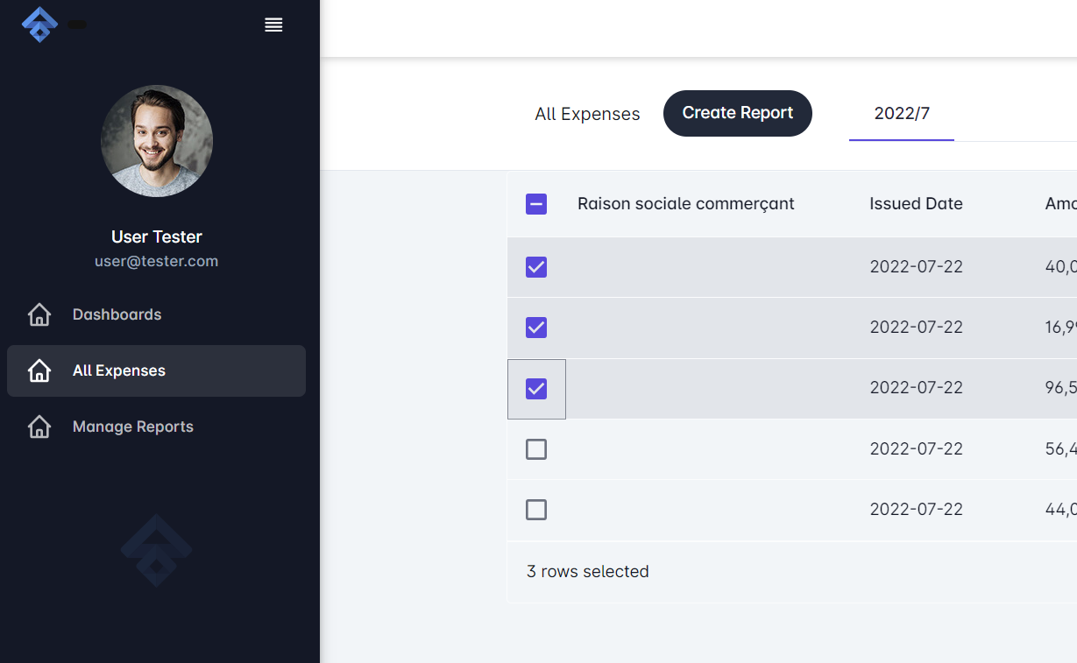
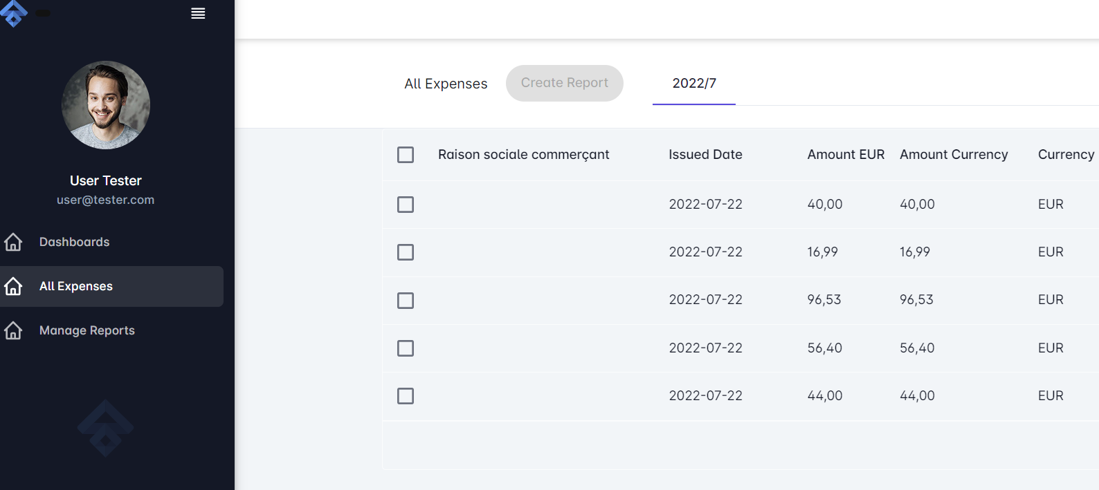
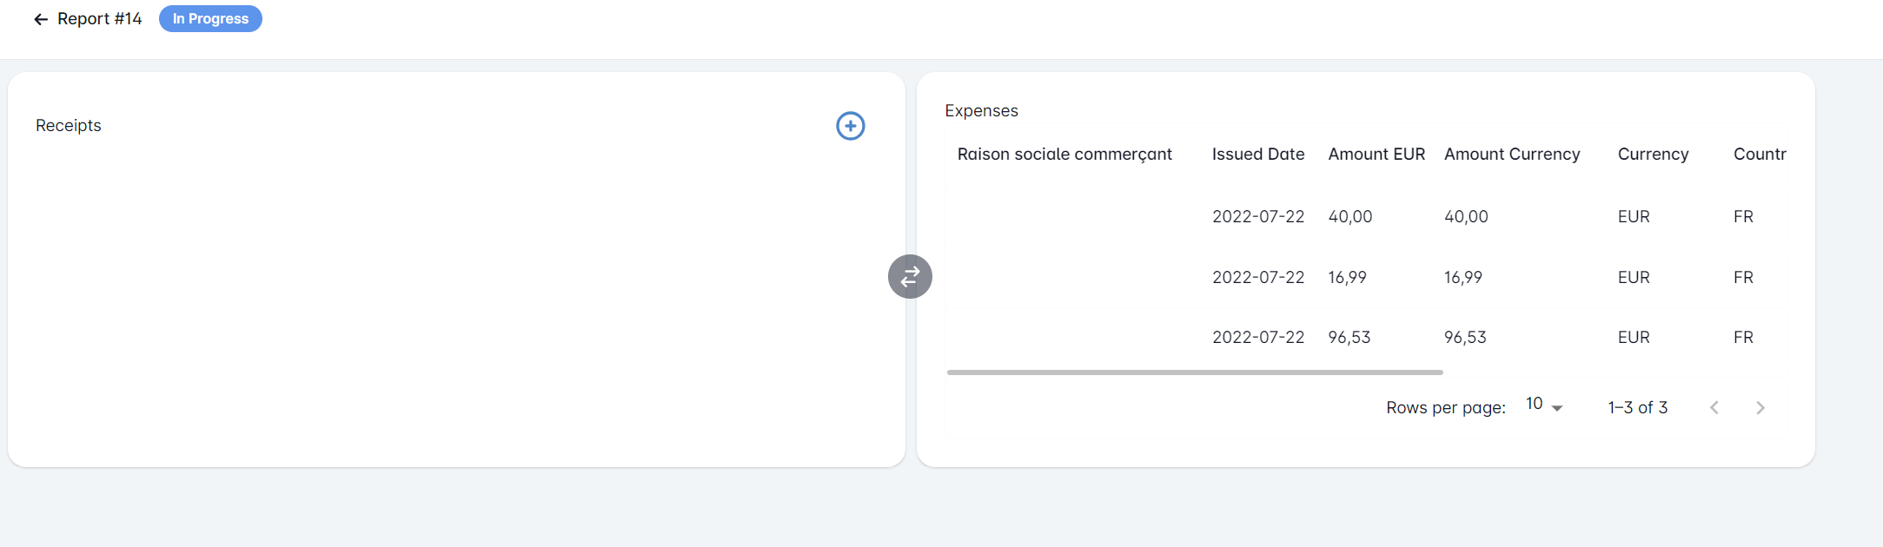
Select expenses, click create report
2. A creates a report

Slide 4
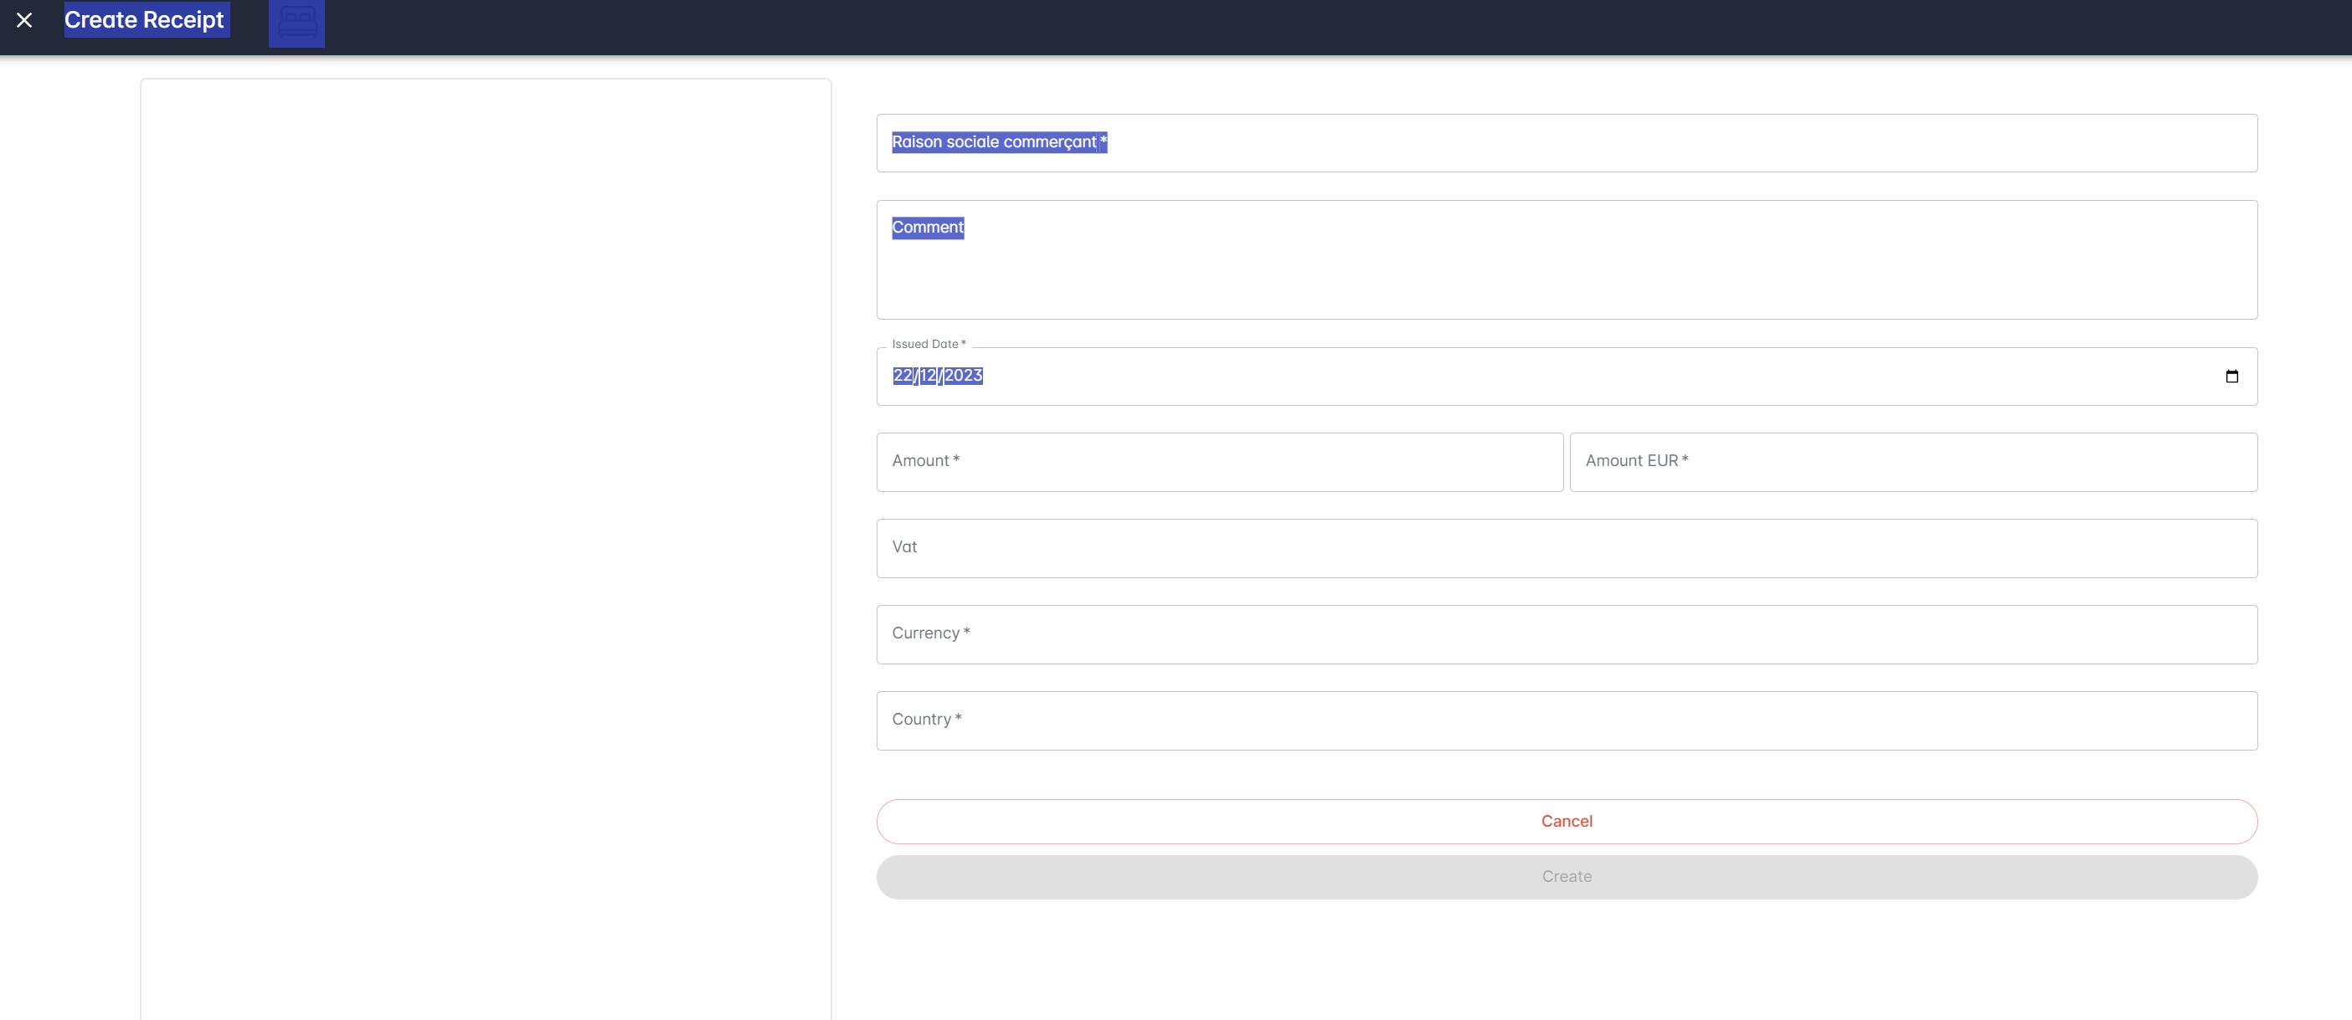
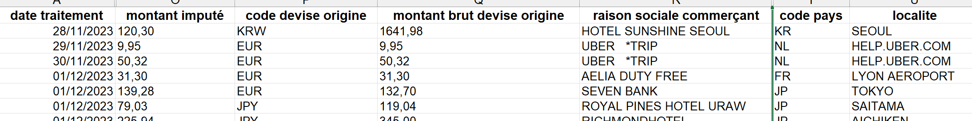
3. Select an expense in the list of expenses (it is highlighted)
4. The corresponding Receipt page is on the left
5. Some fields are automatically filled
6. User will fill in missing fields and select a PDF file
7. When ok, then expense line is green
Some fields are automatically filled:
Raison Sociale Commercant
Issued Date
Amount Currency
Currency
Amount EUR
A must add:
Hotel Sunshine Seoul
28/11/2023
1641,98
KRW
120,30

Slide 5
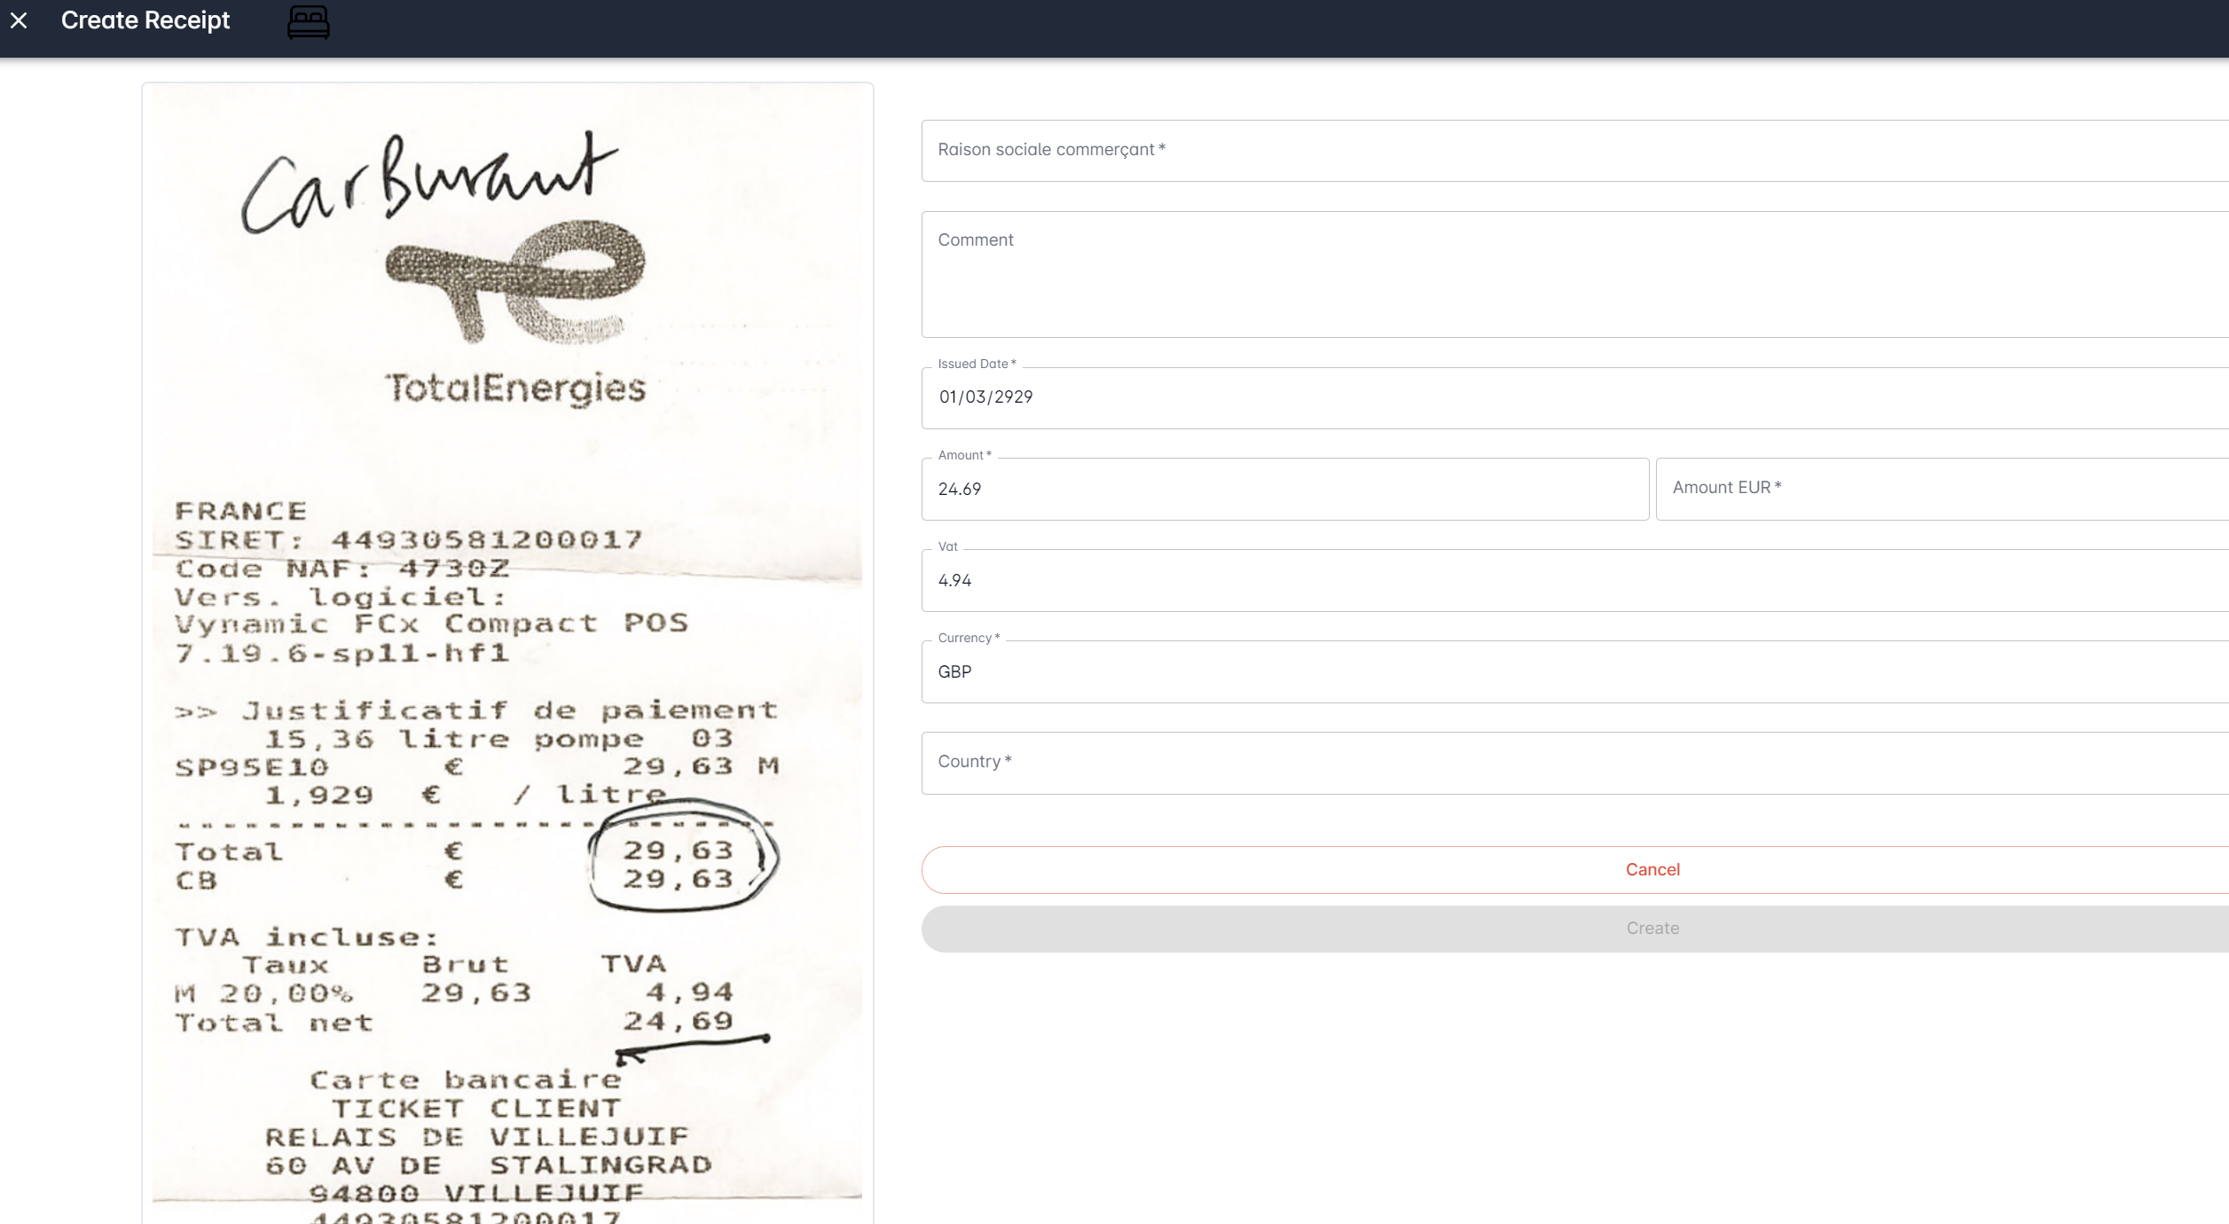
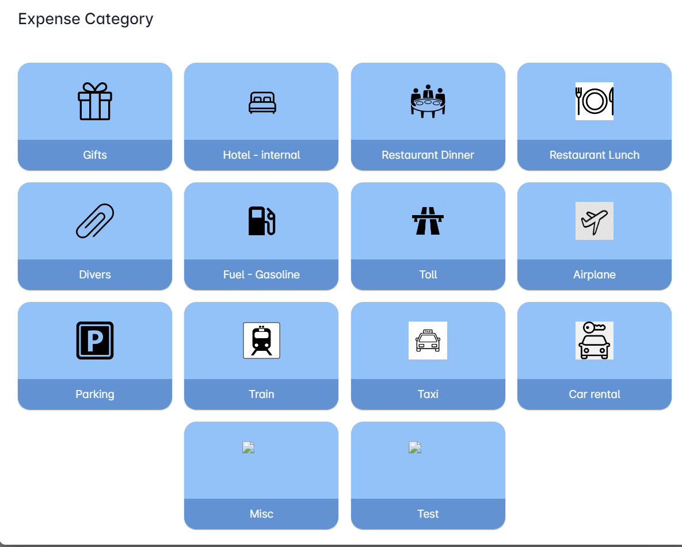
User must
choose PDF
choose Expense Category
Input Comment
Input VAT *
VAT is needed ONLY
in some categories of expenses and only if Country is France.
Yellow fields are automatically filled from Bank expense
User must input red fields
Cannot validate if PDF and Expense Category is not filled.

Slide 6
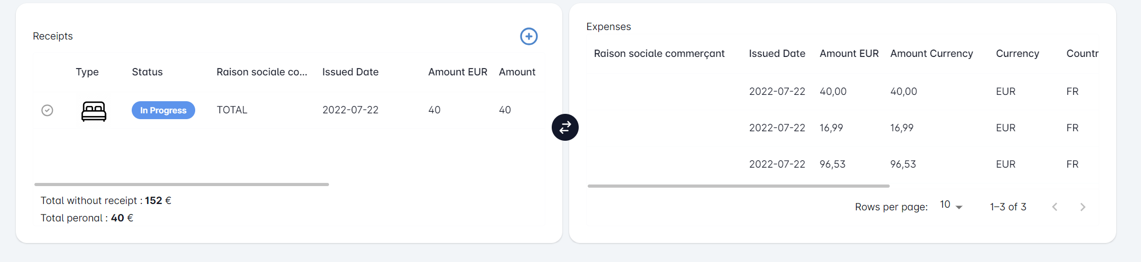
User can still add receipts like Version 1. These receipts are all Personal
Click + to add personal expenses.
A. Submits report when finished

Slide 7
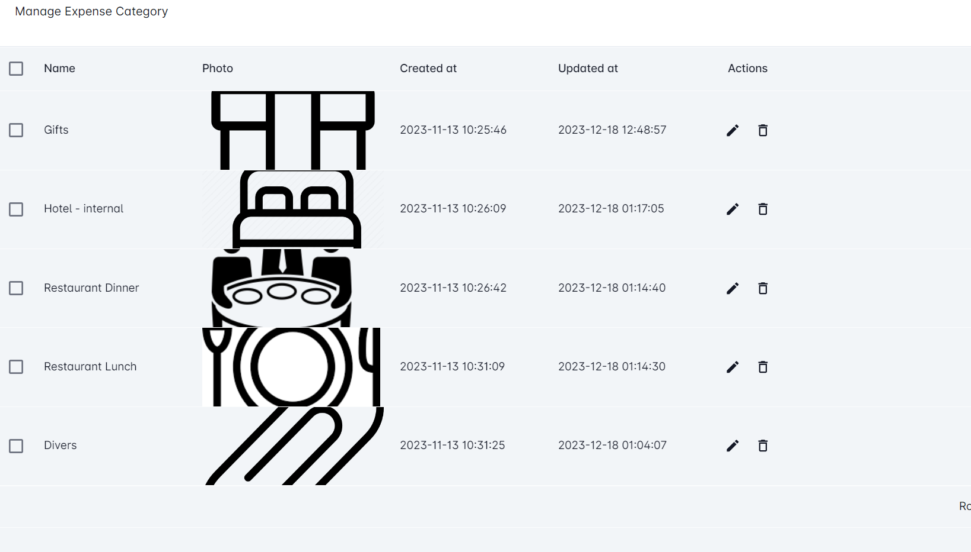
Add a field : VAT possible

Slide 8
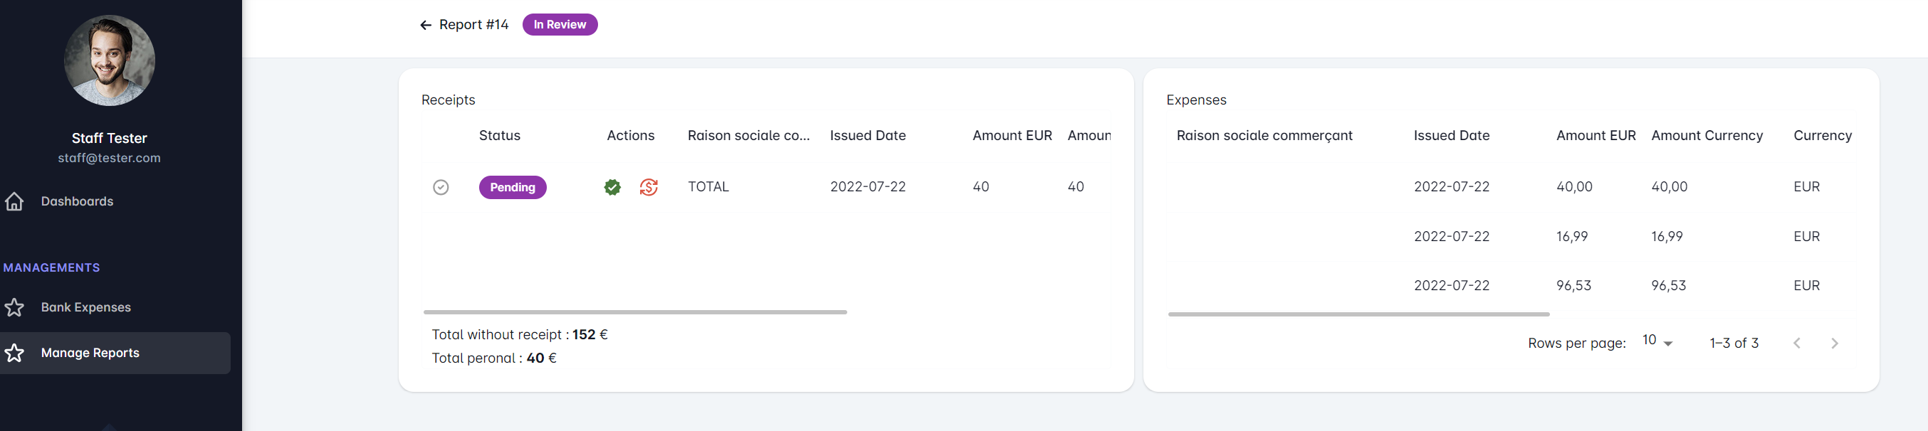
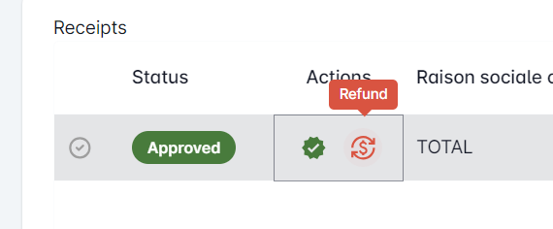
VAT total :
VAT total :
B. Will review
- possible to open each expense and check the receipt
- Approve
- Refund icon is not needed
VAT Total : needed for Personal and Bank Expenses

Slide 9
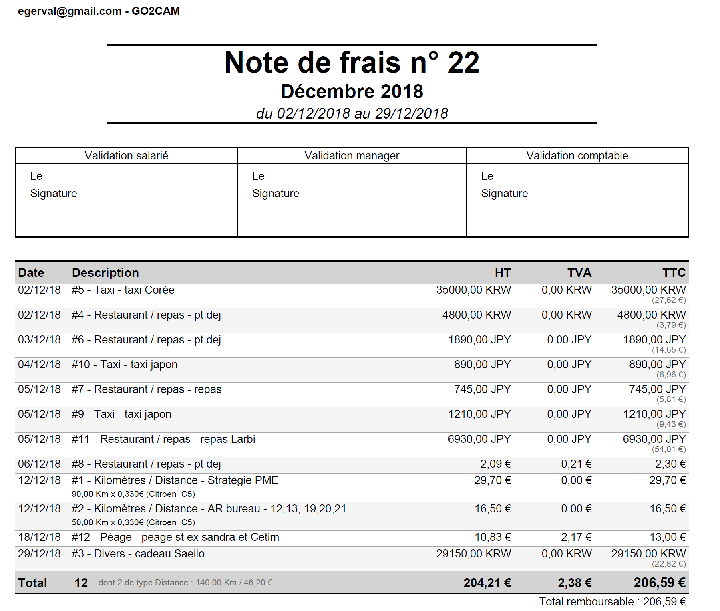
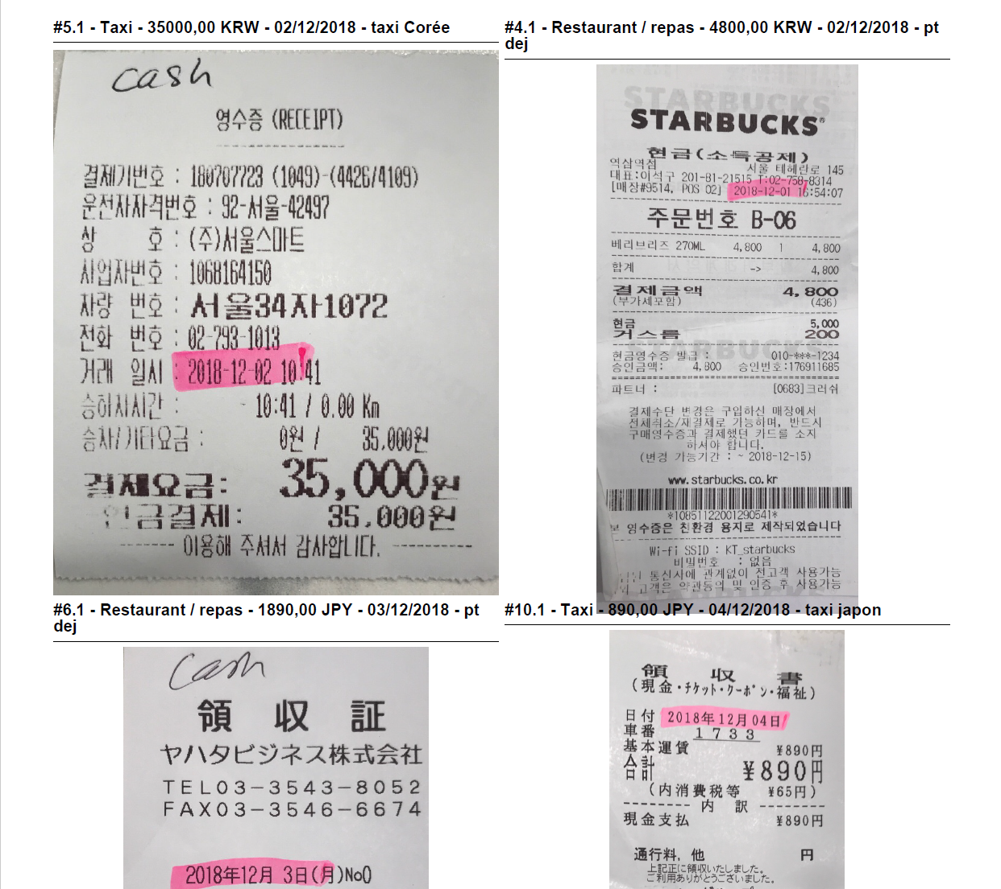
After approval, export PDF and Excel sheet
I will give more details for Excel sheet

